Slide 1
Fundraising
Callie Clark – MT PTA Membership Chair
Stephanie Humphrey – MT PTA Convention Chair

Slide 2
Raise Money
Bring in New Families & Members
Why Are You
Fundraising?
Community Involvement

Slide 3
Raise Money
Bring in New Families & Members
Why Are You
Fundraising?
Community Involvement

Slide 4
Raise Money
Why Are You
Fundraising?
Bring in New Families & Members
Community Involvement

Slide 5
Raise Money
Why Are You
Fundraising?
Bring in New Families & Members
Community Involvement

Slide 6
Raise
Money
Are you raising money for a specific project? | Do you have the space and resources? | How much do you need to raise?

Slide 7
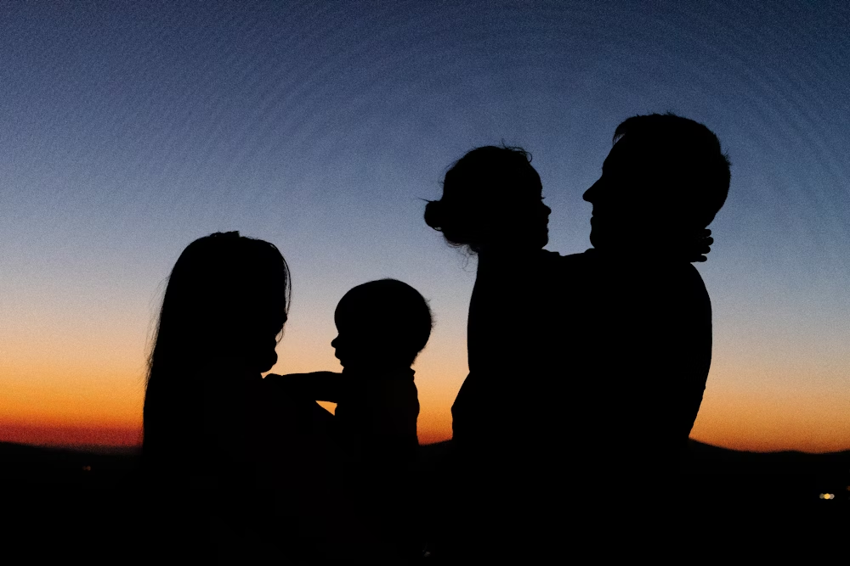
Bring in
New Families
& Members
Do you want to use this fundraiser as a recruiting tool? | Think about what kind of activities a whole family could attend. | Is it affordable for everyone?

Slide 8
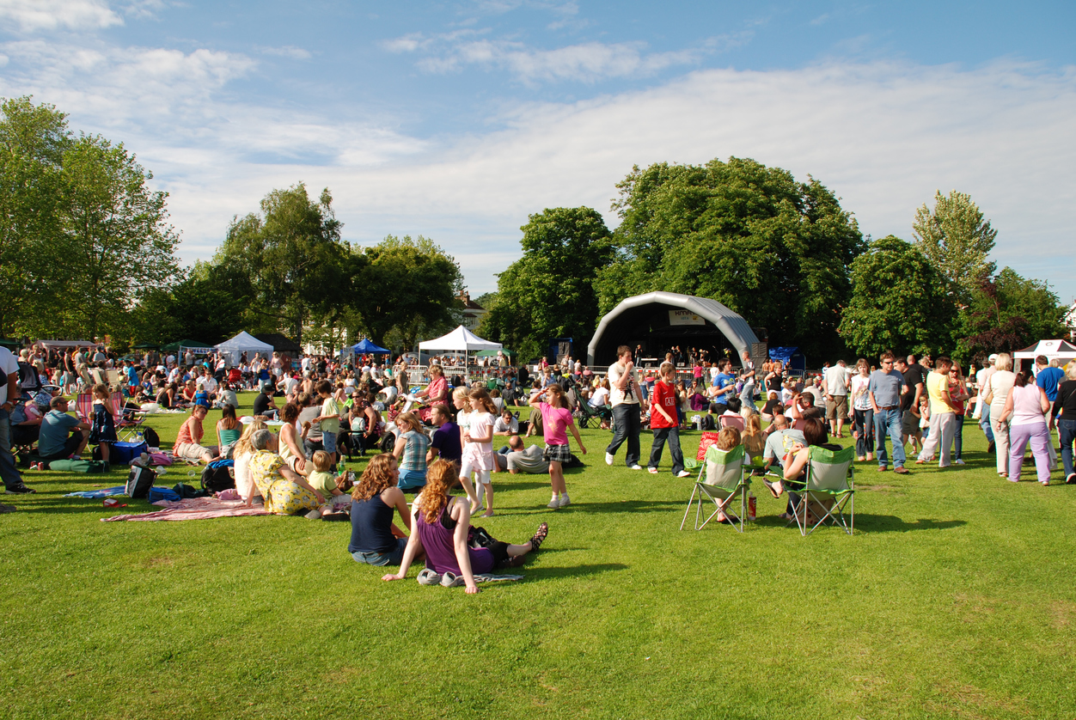
Community
Involvement
Your Local Community is going to be one of your biggest assets. | Get out in your community and let them see your PTA at work. | Remember how important it is to also give back to your community.

Slide 9
Community
Involvement
Corporate/
Donations
Sales
Events
Activities
The Fundraing
Possibilities
Are
Endless
Types of Fundraising and Examples
Singing
Grams
Savings
Cards
Raffles
Savings
Cards
Bingo
Night
Movie
Night
Concerts
Tournaments
Sports
Yard
Signs
Serve At
Restaurants
Community
Calander
A-Thons
School
Merch
Caramel
Apple
Deliveries
Paint
&
Sip
Fun
Run
Race
Send out
Donation Request Letter
Ask
Businesses
For
Donations
Apply
For
Grants
Volunteer
At
Events
Trivia
Night
Carnival
Flamingo
Yards
Corporate
Matching
Pizza
Kits
Fruit
Boxes
Pom
Poms
Family
Game
Night
Talent
Show
Casino
Night
Cook-
Off
Car
Wash
Casino
Night
Community
Yard
Sale
Karaoke
Community
Cookbook
Butter
Braids
Dinner
&
Auction
Make
&
Take
Candy
Haunted
House
Petting
Zoo
Pancake
Breakfast
Traveling
Toilet

Slide 10
Community
Involvement
Corporate/
Donations
Sales
Events
Activities
The Fundraing
Possibilities
Are
Endless
Types of Fundraising and Examples
Singing
Grams
Savings
Cards
Bingo
Night
Field
Day
Raffles
Movie
Night
Concerts
Serve At
Restaurants
Sports
Yard
Signs
Tournaments
Community
Calander
A-Thons
Paint
&
Sip
School
Merch
Caramel
Apple
Deliveries
Send out
Donation Request Letter
Ask
Businesses
For
Donations
Fun
Run
Race
Apply
For
Grants
Volunteer
At
Events
Trivia
Night
Carnival
Flamingo
Yards
Corporate
Matching
Family
Game
Night
Pizza
Kits
Fruit
Boxes
Pom
Poms
Talent
Show
Casino
Night
Cook-
Off
Car
Wash
Casino
Night
Community
Yard
Sale
Karaoke
Community
Cookbook
Make
&
Take
Butter
Braids
Dinner
&
Auction
Candy
Haunted
House
Petting
Zoo
Pancake
Breakfast
Traveling
Toilet

Slide 11
Community
Involvement
Corporate/
Donations
Sales
Activities
Events
The Fundraing
Possibilities
Are
Endless
Types of Fundraising and Examples
Singing
Grams
Savings
Cards
Bingo
Night
Raffles
Field
Day
Movie
Night
Serve At
Restaurants
Sports
Yard
Signs
Concerts
Tournaments
Community
Calander
A-Thons
Paint
&
Sip
School
Merch
Caramel
Apple
Deliveries
Send out
Donation Request Letter
Ask
Businesses
For
Donations
Fun
Run
Race
Apply
For
Grants
Volunteer
At
Events
Trivia
Night
Corporate
Matching
Carnival
Flamingo
Yards
Family
Game
Night
Pizza
Kits
Fruit
Boxes
Pom
Poms
Penny
Wars
Talent
Show
Casino
Night
Cook-
Off
Car
Wash
Community
Yard
Sale
Karaoke
Community
Cookbook
Make
&
Take
Butter
Braids
Dinner
&
Auction
Petting
Zoo
Haunted
House
Candy
Pancake
Breakfast
Traveling
Toilet

Slide 12
Community
Involvement
Corporate/
Donations
Sales
Events
Activities
The Fundraing
Possibilities
Are
Endless
Types of Fundraising and Examples
Singing
Grams
Savings
Cards
Raffles
Savings
Cards
Sports
Yard
Signs
Bingo
Night
Movie
Night
Serve At
Restaurants
Concerts
Tournaments
Community
Calander
A-Thons
School
Merch
Caramel
Apple
Deliveries
Ask
Businesses
For
Donations
Paint
&
Sip
Fun
Run
Race
Send out
Donation Request Letter
Apply
For
Grants
Trivia
Night
Volunteer
At
Events
Flamingo
Yards
Corporate
Matching
Carnival
Pizza
Kits
Fruit
Boxes
Pom
Poms
Family
Game
Night
Talent
Show
Casino
Night
Cook-
Off
Car
Wash
Penny
Wars
Community
Yard
Sale
Karaoke
Community
Cookbook
Butter
Braids
Dinner
&
Auction
Make
&
Take
Candy
Haunted
House
Petting
Zoo
Pancake
Breakfast
Traveling
Toilet

Slide 13
Community
Involvement
Corporate/
Donations
Sales
Events
Activities
The Fundraing
Possibilities
Are
Endless
Types of Fundraising and Examples
Singing
Grams
Savings
Cards
Raffles
Savings
Cards
Bingo
Night
Movie
Night
Concerts
Tournaments
Sports
Yard
Signs
Serve At
Restaurants
Community
Calander
A-Thons
School
Merch
Caramel
Apple
Deliveries
Ask
Businesses
For
Donations
Paint
&
Sip
Fun
Run
Race
Send out
Donation Request Letter
Apply
For
Grants
Trivia
Night
Volunteer
At
Events
Corporate
Matching
Carnival
Flamingo
Yards
Pizza
Kits
Fruit
Boxes
Pom
Poms
Family
Game
Night
Talent
Show
Casino
Night
Cook-
Off
Car
Wash
Casino
Night
Community
Yard
Sale
Karaoke
Community
Cookbook
Butter
Braids
Dinner
&
Auction
Make
&
Take
Candy
Haunted
House
Petting
Zoo
Pancake
Breakfast
Traveling
Toilet

Slide 14
Community
Involvement
Corporate/
Donations
Sales
Events
Activities
The Fundraising
Possibilities
Are
Endless
Types of Fundraising and Examples
Singing
Grams
Savings
Cards
Raffles
Savings
Cards
Bingo
Night
Movie
Night
Concerts
Tournaments
Sports
Yard
Signs
Serve At
Restaurants
Community
Calander
A-Thons
School
Merch
Caramel
Apple
Deliveries
Paint
&
Sip
Fun
Run
Race
Send out
Donation Request Letter
Ask
Businesses
For
Donations
Apply
For
Grants
Volunteer
At
Events
Trivia
Night
Carnival
Flamingo
Yards
Corporate
Matching
Pizza
Kits
Fruit
Boxes
Pom
Poms
Family
Game
Night
Talent
Show
Casino
Night
Cook-
Off
Car
Wash
Casino
Night
Community
Yard
Sale
Karaoke
Community
Cookbook
Butter
Braids
Dinner
&
Auction
Make
&
Take
Candy
Haunted
House
Petting
Zoo
Pancake
Breakfast
Traveling
Toilet

Slide 15
Community
Involvement
Corporate/
Donations
Sales
Events
Activities
The Fundraising
Possibilities
Are
Endless
Types of Fundraising and Examples
Singing
Grams
Savings
Cards
Raffles
Savings
Cards
Bingo
Night
Movie
Night
Concerts
Tournaments
Sports
Yard
Signs
Serve At
Restaurants
Community
Calander
A-Thons
School
Merch
Caramel
Apple
Deliveries
Paint
&
Sip
Fun
Run
Race
Send out
Donation Request Letter
Ask
Businesses
For
Donations
Apply
For
Grants
Volunteer
At
Events
Trivia
Night
Carnival
Flamingo
Yards
Corporate
Matching
Pizza
Kits
Fruit
Boxes
Pom
Poms
Family
Game
Night
Talent
Show
Casino
Night
Cook-
Off
Car
Wash
Casino
Night
Community
Yard
Sale
Karaoke
Community
Cookbook
Butter
Braids
Dinner
&
Auction
Make
&
Take
Candy
Haunted
House
Petting
Zoo
Pancake
Breakfast
Traveling
Toilet

Slide 16
Thank you

